Slide 1
Comparison of Ridge and Lasso

Slide 2
Ridge, LASSO - Computational complexity
Solution to ridge regression:
The solution to the LASSO regression:
LASSO has no conventional analytical solution, as the L1 norm has no derivative at zero. We can, however, use the concept of subdifferential or subgradient to find a manageable expression.

Slide 3
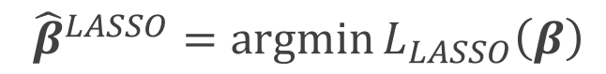
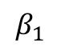
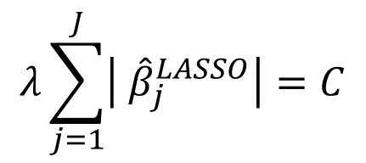

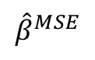
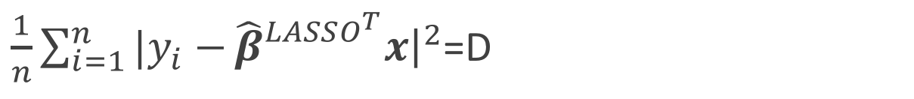
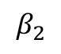
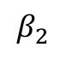
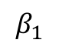
The Geometry of Regularization (LASSO)
$$L_{LASSO}\left(β\right)=\frac{1}{n}\sum_{i=1}^{n}{|y_{i}−}β^{T}x{\left.​\right|}^{2}+λ\sum_{j=1}^{J}{|β_{j}|}$$
$${\hat{β}}^{LASSO}=argmin{L_{LASSO}\left(β\right)}$$
$$λ\sum_{j=1}^{J}{\left| {\hat{β}}_{j}^{LASSO}\right|=C}$$
$\frac{1}{n}\sum_{i=1}^{n}{|y_{i}−}{\hat{β}}_{}^{LASSO^{T}}x{\left.​\right|}^{2}$=D
$$β_{2}$$
$$β_{2}$$
C
$${\hat{β}}^{MSE}$$
MSE=D
C
$$β_{1}$$
$$β_{1}$$

Slide 4
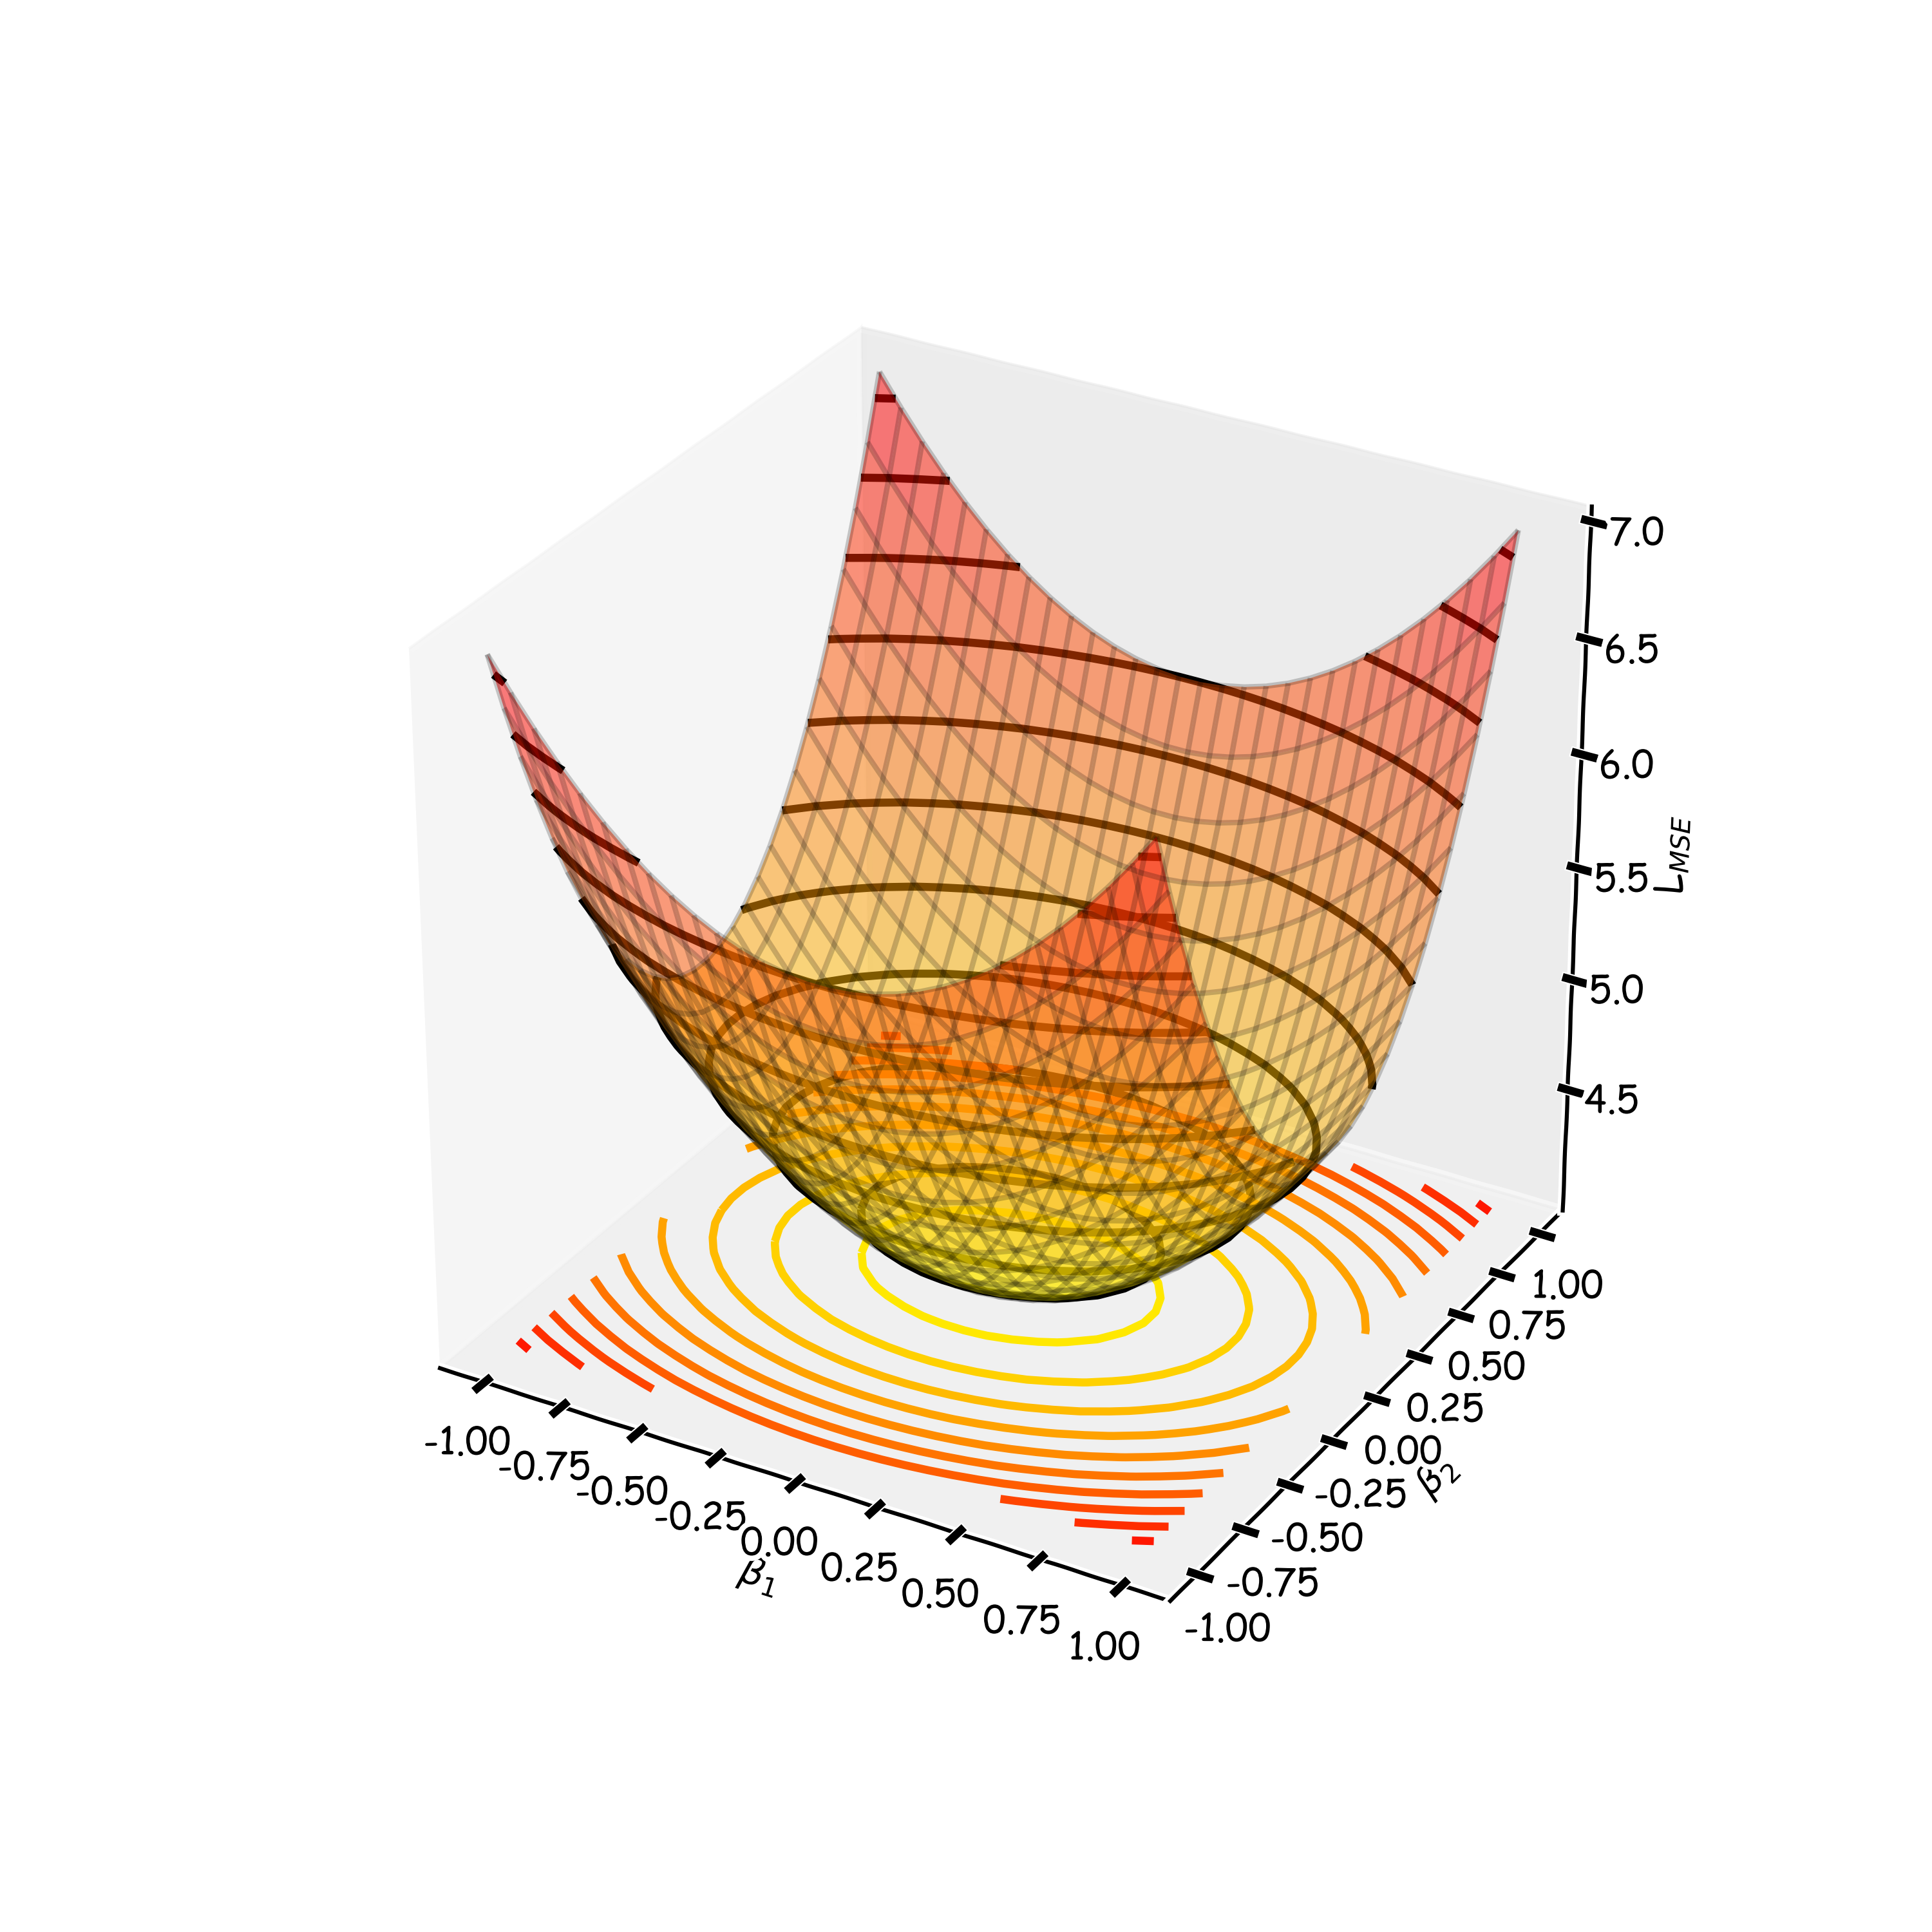
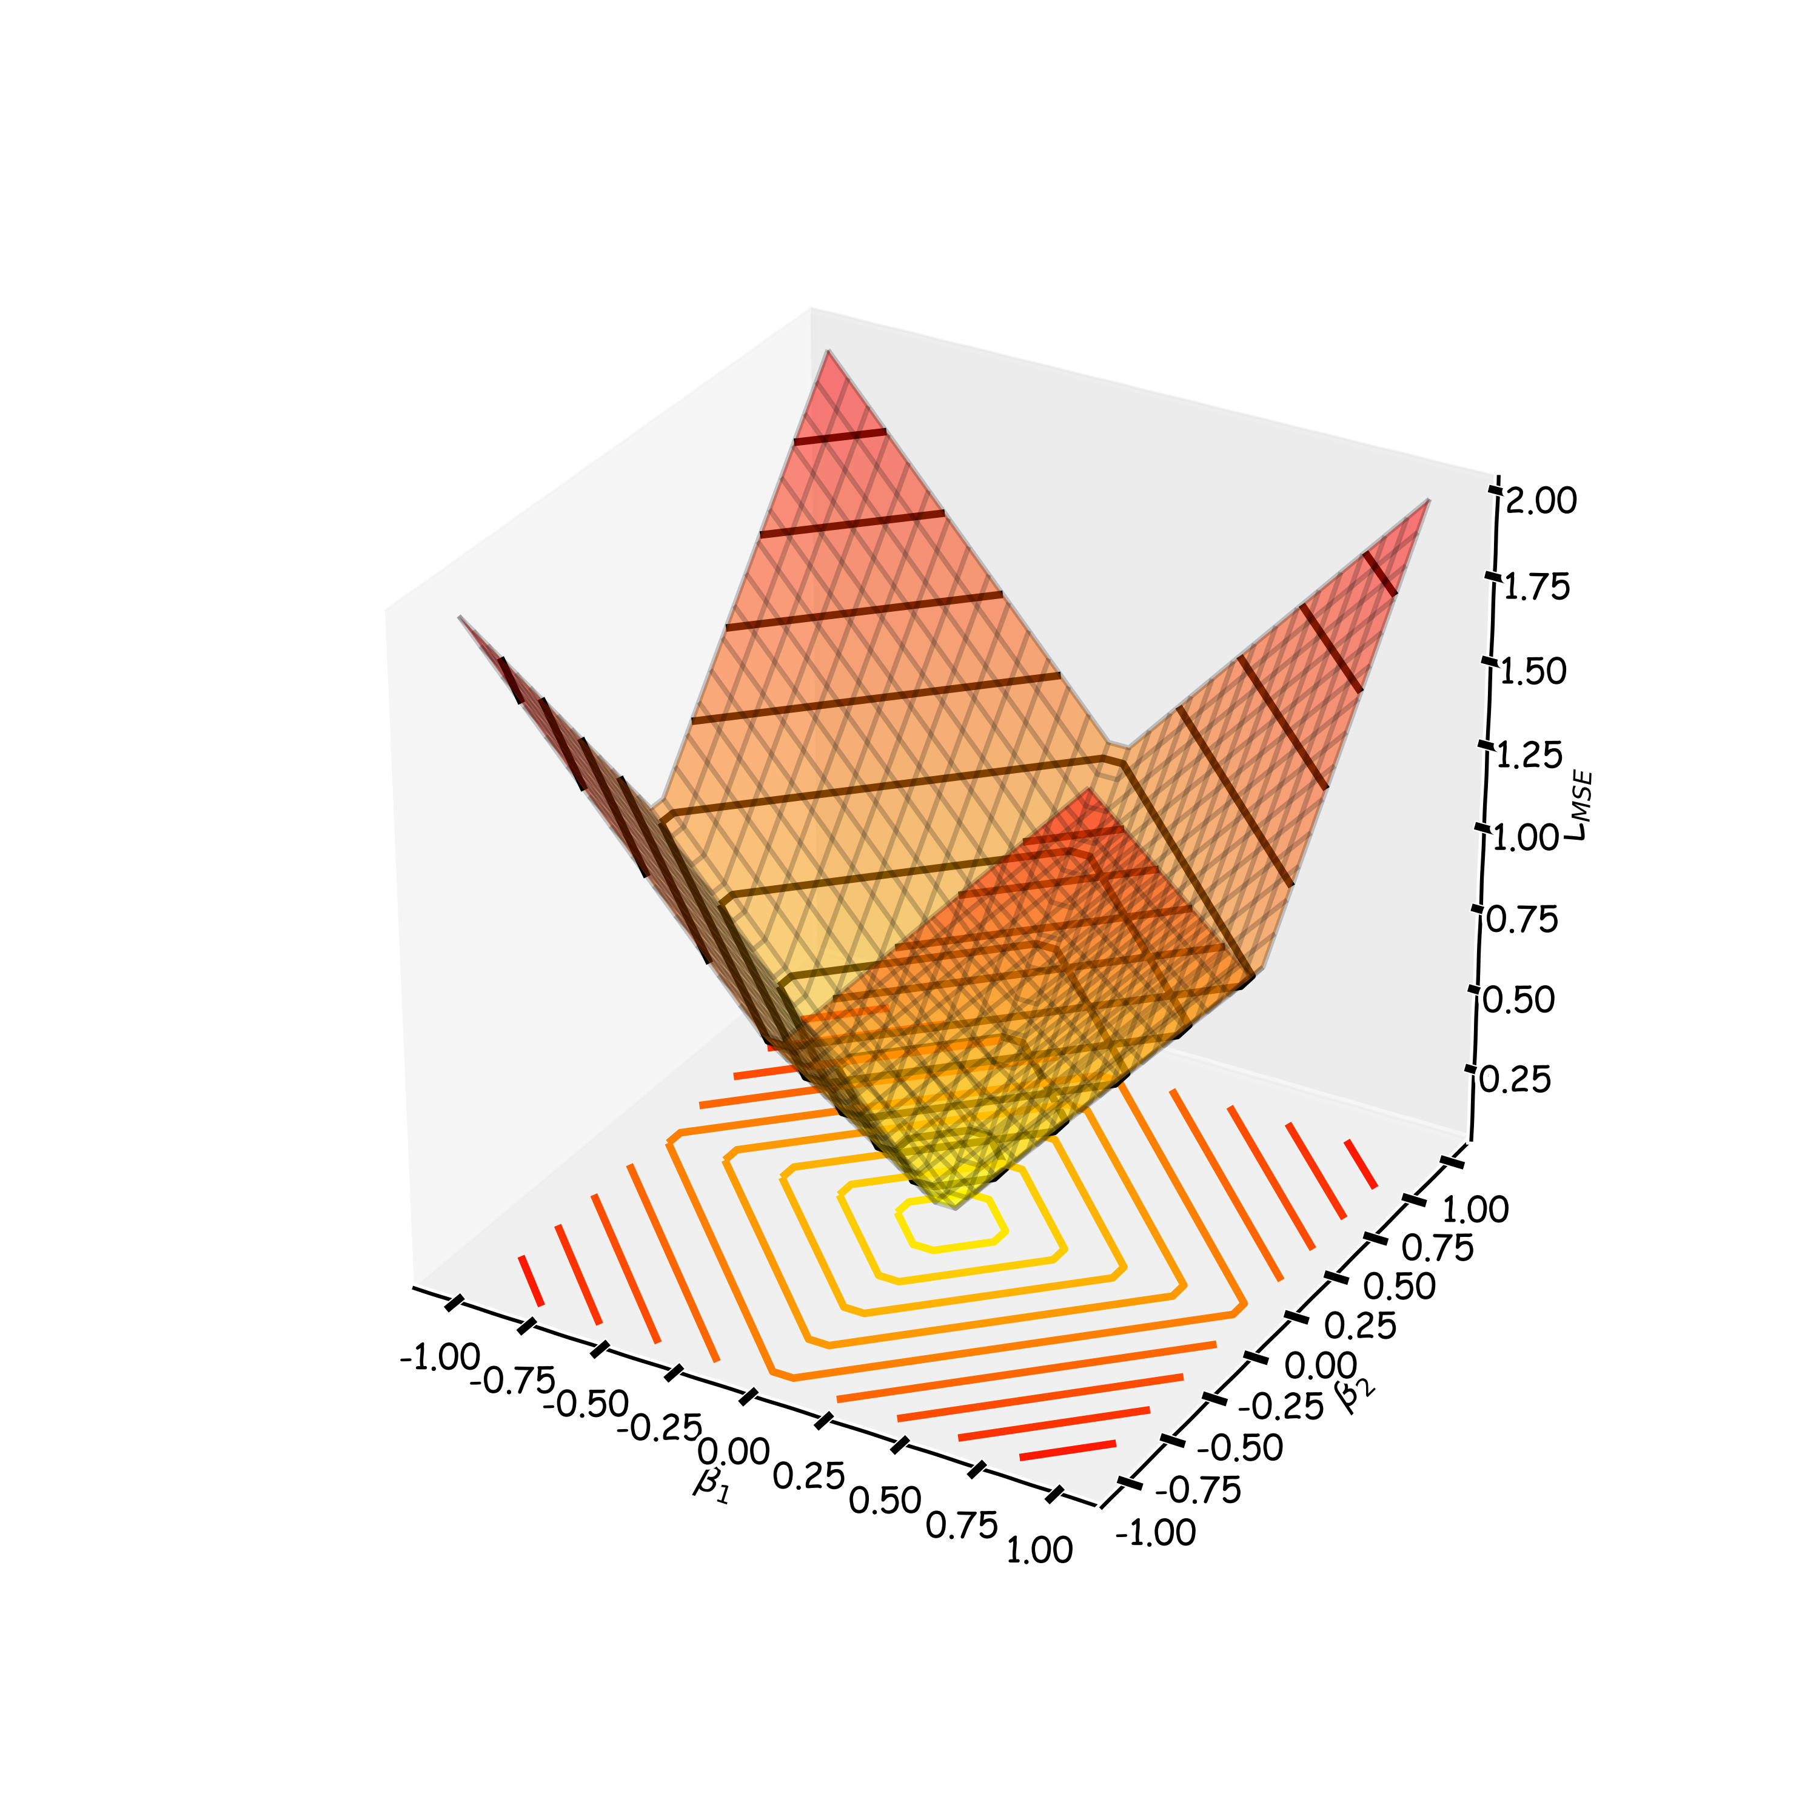
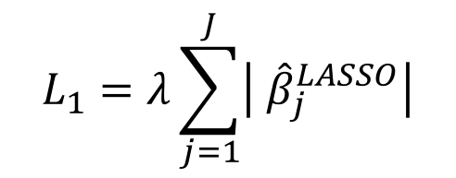

The Geometry of Regularization (LASSO)
$$L_{LASSO}\left(β\right)=\frac{1}{n}\sum_{i=1}^{n}{|y_{i}−}β^{T}x{\left.​\right|}^{2}+λ\sum_{j=1}^{J}{|β_{j}|}$$
$${\hat{β}}^{LASSO}=argmin{L_{LASSO}\left(β\right)}$$
$$L_{1}=λ\sum_{j=1}^{J}{\left| {\hat{β}}_{j}^{LASSO}\right|}$$
$$L_{MSE}\left(β\right)=\frac{1}{n}\sum_{i=1}^{n}{|y_{i}−}β^{T}x{\left.​\right|}^{2}$$

Slide 5
The Geometry of Regularization (LASSO)
$$L_{LASSO}\left(β\right)=\frac{1}{n}\sum_{i=1}^{n}{|y_{i}−}β^{T}x{\left.​\right|}^{2}+λ\sum_{j=1}^{J}{|β_{j}|}$$
$${\hat{β}}^{LASSO}=argmin{L_{LASSO}\left(β\right)}$$
$$λ\sum_{j=1}^{J}{\left| {\hat{β}}_{j}^{LASSO}\right|=C}$$
$\frac{1}{n}\sum_{i=1}^{n}{|y_{i}−}{\hat{β}}_{}^{LASSO^{T}}x{\left.​\right|}^{2}$=D
$$β_{2}$$
$$β_{2}$$
C
$${\hat{β}}^{MSE}$$
MSE=D
C
$$β_{1}$$
$$β_{1}$$

Slide 6
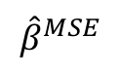
The Geometry of Regularization (LASSO)
$$β_{2}$$
$$β_{2}$$
$$β_{2}$$
$${\hat{β}}^{MSE}$$
MSE=D
C
C
$${\hat{β}}^{MSE}$$
MSE=D
C
C
$$β_{1}$$
$$β_{1}$$
$$β_{1}$$

Slide 7
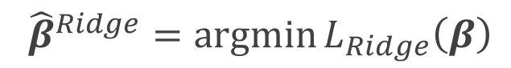

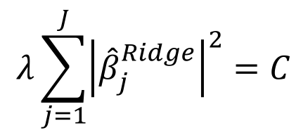
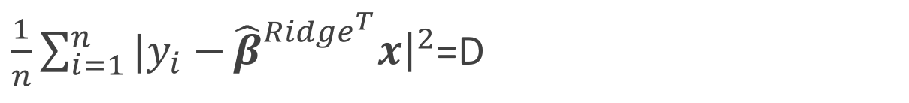
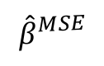
The Geometry of Regularization (Ridge)
$$L_{Ridge}\left(β\right)=\frac{1}{n}\sum_{i=1}^{n}{|y_{i}−}β^{T}x{\left.​\right|}^{2}+λ\sum_{j=1}^{J}{{\left(β_{j}\right)}^{2}}$$
$${\hat{β}}^{Ridge}=argmin{L_{Ridge}\left(β\right)}$$
$$λ\sum_{j=1}^{J}{{\left|{\hat{β}}_{j}^{Ridge}\right|}^{2}=C}$$
$\frac{1}{n}\sum_{i=1}^{n}{|y_{i}−}{\hat{β}}_{}^{{Ridge}^{T}}x{\left.​\right|}^{2}$=D
$$β_{2}$$
$$β_{2}$$
$${\hat{β}}^{MSE}$$
MSE=D
C
$$β_{1}$$
$$β_{1}$$

Slide 8
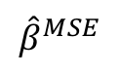
The Geometry of Regularization (Ridge)
$$β_{2}$$
$${\hat{β}}^{MSE}$$
MSE=D
C
$$β_{1}$$

Slide 9
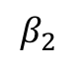
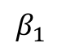
The Geometry of Regularization
$$β_{2}$$
$$β_{2}$$
$${\hat{β}}^{MSE}$$
MSE=D
$${\hat{β}}^{MSE}$$
MSE=D
C
C
C
$$β_{1}$$
$$β_{1}$$

Slide 10


Slide 11
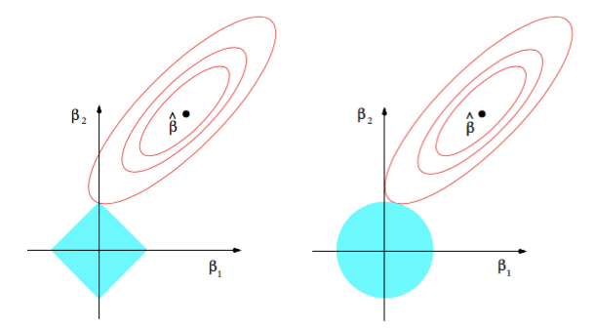
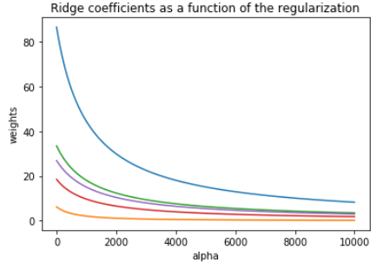
Ridge visualized
Ridge estimator
The ridge estimator is where the constraint and the loss intersect.
The values of the coefficients decrease as lambda increases, but they are not nullified.

Slide 12
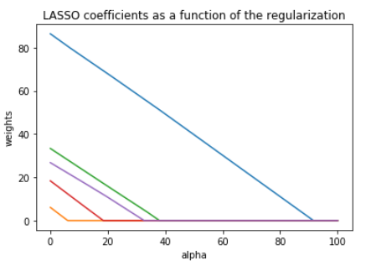
LASSO visualized
Lasso estimator
The Lasso estimator tends to zero out parameters as the OLS loss can easily intersect with the constraint on one of the axis.
The values of the coefficients decrease as lambda increases and are nullified fast.

Slide 13
Variable Selection as Regularization
Question: What are the pros and cons of the two approaches?
Since LASSO regression tends to produce zero estimates for a number of model parameters - we say that LASSO solutions are sparse - we consider LASSO to be a variable selection method.
Ridge is faster to compute but many prefer using LASSO for variable selection (as well as for suppressing extreme parameter values) and therefore easier to interpret.

